Slide 1
Understanding Olympic Medal Success: A Country-Level Data and Infividual Approach
Predicting Olympic Medal Success: A Country-Level Data Science Approach
Group A
Maxim Lisiansky, Noam Ben Moshe, Roy Kremer, Romi Richter, Avraham Elbaz

Slide 2

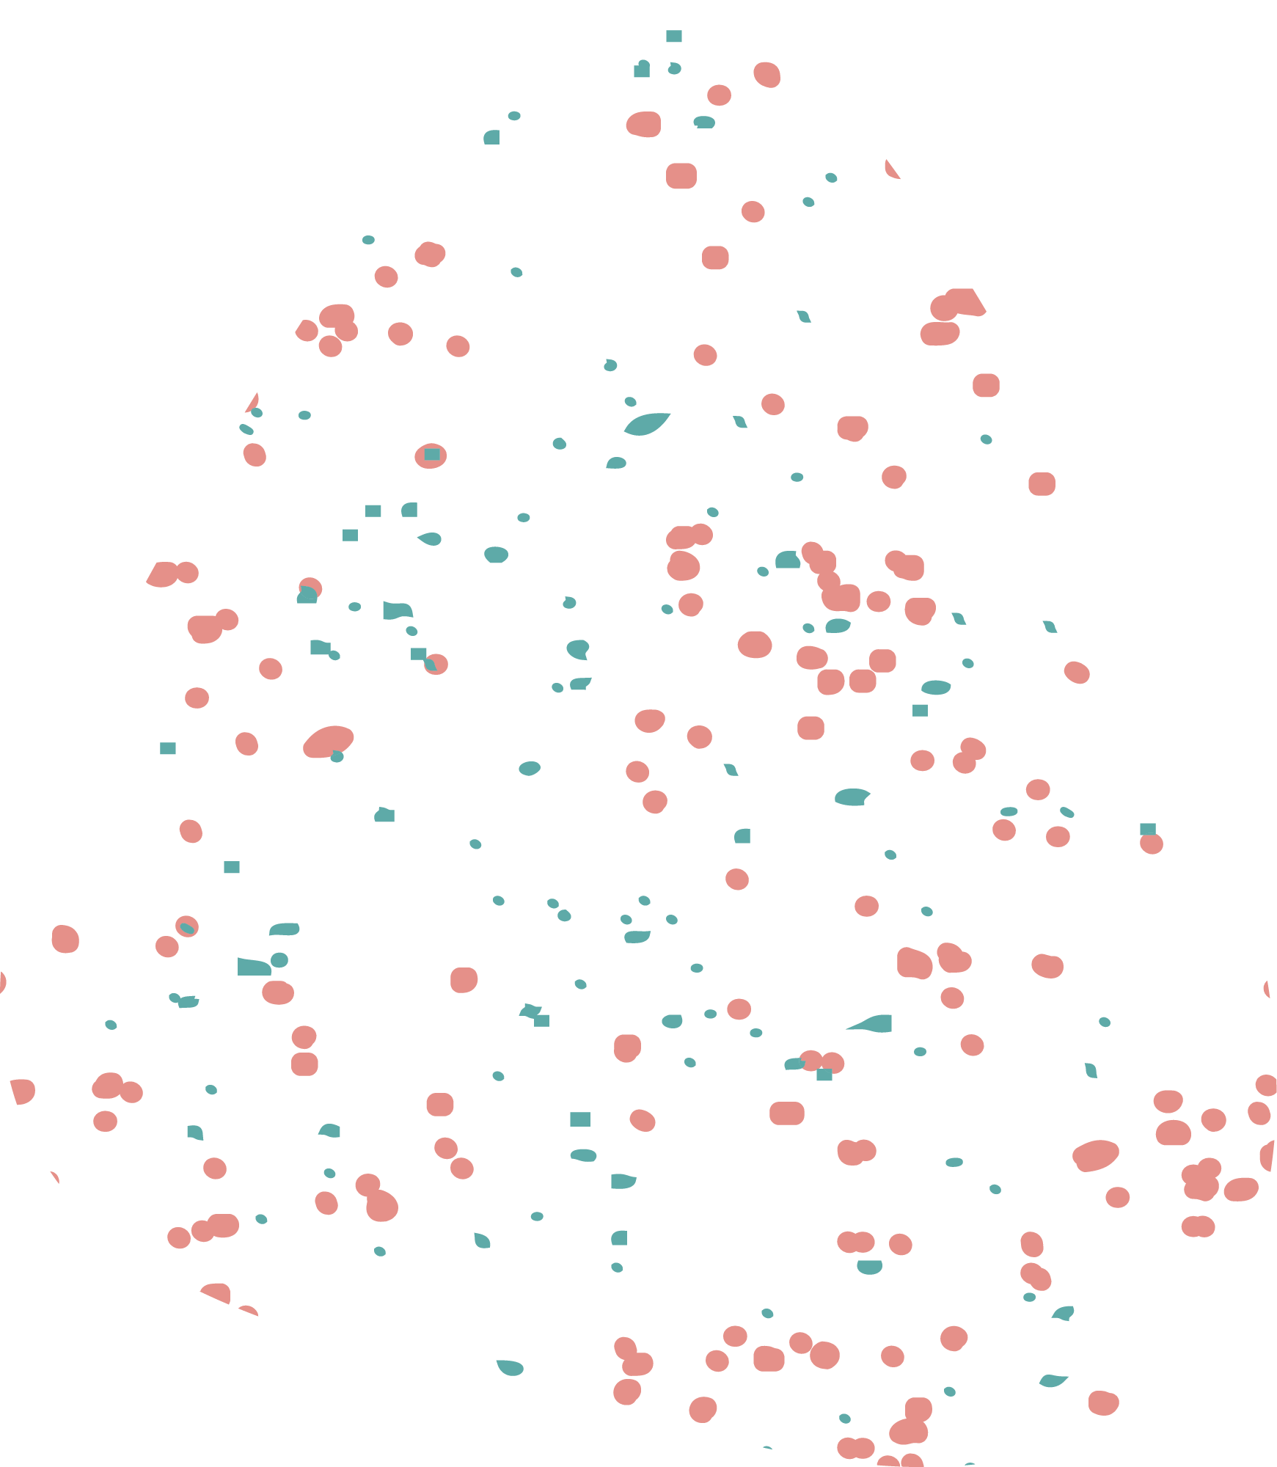
Which country-level factors are most important in predicting Olympic medal counts?

Slide 3
Motivation:
Latest Work
New data
New Models
More wide approach
Latest work found is from 2014 ish
The data explored spans over more than 4 decades
New models and approaches of recent years
Including a wide range of models,data and analysis

Slide 4
Related Work:
01
02
03
Article 1
Article 2
Article 3
04
05
Article 4
Article 5
Predicting Olympic Medal Counts: the Effects of Economic Development on Olympic
The (Non) Determinants of Olympic Success, showing that features do not always correlate to success
Who Wins the Olympic Games: Economic Resources and Medal Totals
Team Payroll Versus Performance in Professional Sports: Is Increased Spending Associated with Greater Success?"
Olympic Success and ASEAN Countries: Economic Analysis and Policy Implications

Slide 5


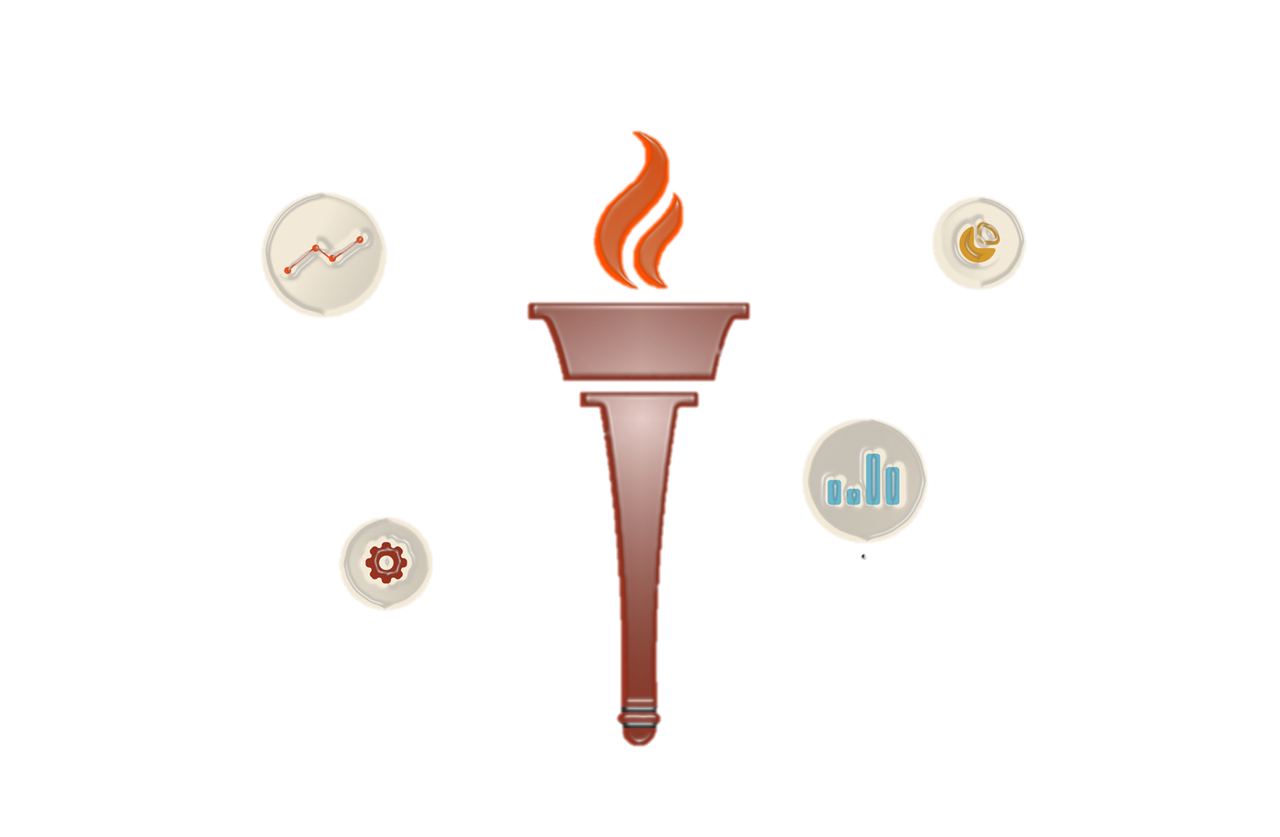
Our Data

Slide 6
Data sets
CountriesGDP 1960-2020
olympic_hosts
63 entries
Features:
Type ,GamesUrl,Disciplines .DisciplinesList,Country,Date ,Athletes,Countries ,Events ,City,Year
20 Missing Values
120 entries
Features:
Contry Name, Country Code, Years 1960 through 2020
1 Missing values
01
02
03
04
05
athlete_events
Regime_df
API_SP.POP.TOTL_DS2_en_csv_v2_131993
69793 entries
Features:
ID,Name,Sex,Age,Height,Weight,Team,NOC,Games,Year,Season,City,Sport,Event,Medal
68,534 Missing values
A newly created df using Wikipedia which states the countries that were under a communist regime.
Features:
Country.Country_Code,Year,Regime
266 entries
Features:
Contry Name, Country Code, Indicator Name, Indicator Code, Years 1960-2024
266 Missing values

Slide 7

Data Preprocessing Steps
Standardized country names across all datasets (lowercase, no spaces, consistent codes) to ensure successful joins.
Resolved issues with alternative country names and changes over time (e.g., “USA” vs. “United States”).
Removed all rows where either GDP or population was missing for a given country-year.
Specifically counted and reported the number of medal-winning rows dropped due to missing GDP or population, highlighting possible data loss.
Aggregated athlete-level medals to country-year and country-level totals.
Engineered binary indicators:
Host (1 if country hosted that year)
Regime (1 if communist regime that year, based on known periods)
Created “number of games attended” per country for cumulative analysis.
Standardized (z-score) the transformed features to put all numeric variables on comparable scales. (which were dropped for later models).
Separated the data into Summer and Winter Olympics, as well as further splitting into training and test sets for each scenario.
Notes:
להסביר שזה התהליך המסובך בפרויקט, כדי למצוא מסקנות מעניינות ולהרחיב פה

Slide 8

Methodology:
Modeling
Approach
Evaluation
Metrics
Notes:
Methodology
Bullet Points:
Data Integration
Merged athlete participation, GDP, population, and host country data into a single panel.
Standardized country names and handled missing values.
Feature Engineering
Created log-normalized and standardized GDP & population features.
Binary indicators: Host status, regime type.
Aggregated medal counts and calculated “number of games attended.”
Modeling Approach
Tried several regression models:
Poisson Regression (for count data)
Linear Regression
Random Forest Regressor
XGBoost Regressor
Used scikit-learn pipelines for reproducibility.
Trained and evaluated models separately for Summer and Winter Olympics, at both country-year and aggregate country levels.
Evaluation Metrics
R² (explained variance)
Feature importance (coefficients and permutation importance)

Slide 9

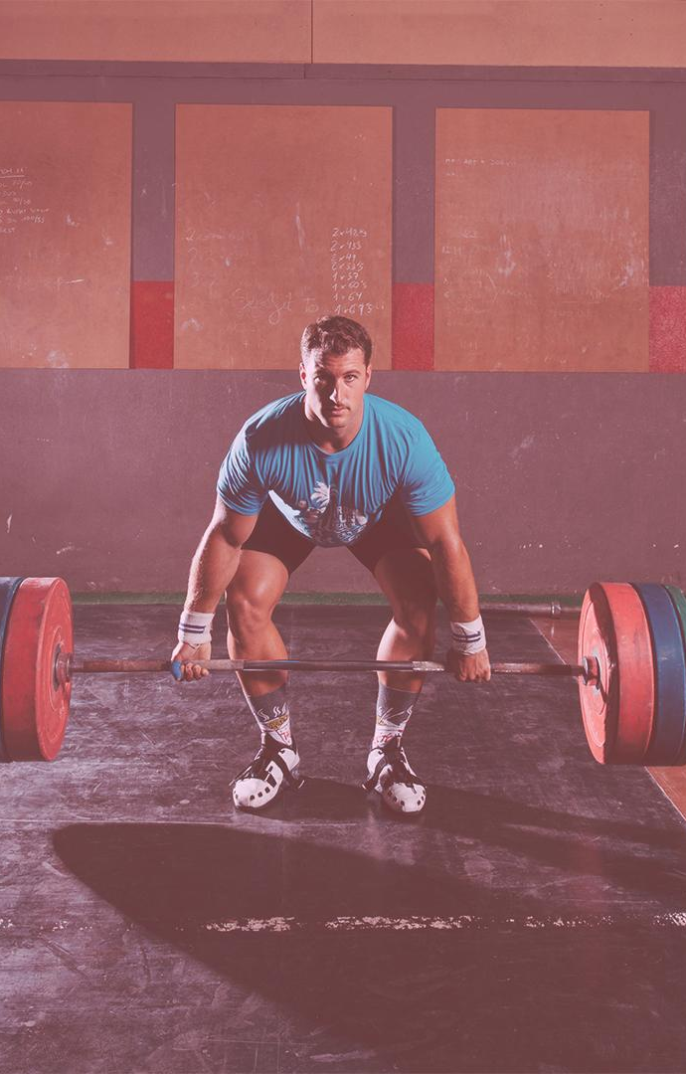
Challenges with the data:
Inconsistent Country Names and Missing Data
Right-Skewed Distributions and sparsity in Medal Wins
Small Sample Size for Some Aggregations and complexity of Regime Classification:
Notes:
Challenges and How They Were Addressed
Inconsistent Country Names:
Multiple naming conventions and historical changes (e.g., “USSR”, “Russia”, “East Germany”) required careful normalization and mapping.
Some countries split or merged during the analysis period, complicating longitudinal joins.
Missing Data:
Many country-year records lacked GDP or population values, especially for smaller or newly formed countries.
This led to the exclusion of some medal-winning entries, potentially biasing the analysis towards better-documented, larger economies.
All merges used inner or left joins as appropriate, and missing data was tracked and reported for transparency.
Right-Skewed Distributions:
Both GDP and population were heavily skewed, with most countries having low values and a few outliers.
This was solved by log-transforming and then standardizing these features.
Sparsity in Medal Wins:
The majority of country-year pairs have zero medals, making the dataset highly imbalanced for predictive modeling.
Models were evaluated with this in mind, and in some cases, countries that never won a medal were filtered out for aggregate-level analysis.
Small Sample Size for Some Aggregations:
When aggregating at the country level (e.g., for total medals won over decades), the dataset becomes quite small, reducing statistical power and making advanced modeling challenging.
Results and feature importances were interpreted cautiously in these scenarios.
Complexity of Regime Classification:
Assigning regime status over time required manual lists and historical knowledge, and regime changes were tracked per country-year.

Slide 10
RESULTS AND ANALYSIS OF SUMMER GAMES
 | PoissonReg | LinearReg | RFRegressor | XGBRegressor
PoissonReg | 0.768 | 0.0011 | 0.1898 | 0.0486
LinearReg | - | 0.307 | 0.0932 | 0.1222
RFRegressor | - | - | 0.847 | 0.0351
XGBRegressor | - | - | - | 0.832
Notes:
אלכסון זה R2
שאר התאים זה p_value of paired t-test
. Overall Conclusions & Recommendations
PoissonRegressor is statistically better than both LinearRegression and XGBoost in terms of MAE.
RandomForestRegressor is statistically better than XGBoost.
No significant difference exists between:
PoissonRegressor vs RandomForestRegressor
LinearRegression vs RandomForestRegressor
LinearRegression vs XGBoost
Practical Takeaways
If your main criterion is absolute prediction error (MAE), PoissonRegressor and RandomForestRegressor are tied at the top, with no significant difference between them.
PoissonRegressor also has the advantage of modeling count data natively (Medals_Count).
LinearRegression consistently underperforms compared to Poisson and Random Forest (significant difference).
XGBoost performs worse than both Poisson and Random Forest (significant difference), but not significantly different from Linear Regression.
Feature Importance:
GDP_norm is by far the most important feature across all models, demonstrating that a country’s economic strength is the key predictor of Olympic medal success in the Summer Games.
Population_norm provides some additional predictive power, but its effect is much smaller than GDP.
Host and Regime had zero or negligible importance in every model, indicating that, after controlling for GDP and population, these factors do not explain further variation in medal counts.
Takeaway:
Ensemble regression models (Random Forest and XGBoost) are best for predicting medal counts with numeric country-level features.
Economic strength (GDP) overwhelmingly determines Olympic success, with population contributing marginally.
Hosting the games or being a communist regime does not provide additional predictive value for medal counts in the Summer Olympics when economic and population factors are included.

Slide 11
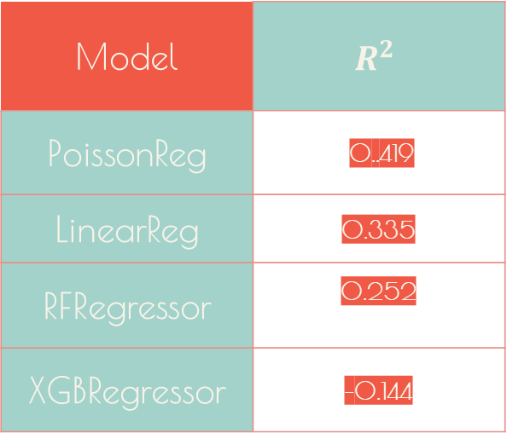
RESULTS AND ANALYSIS OF WINTER GAMES
Model | $$R^{2}$$
PoissonReg | 0..419
LinearReg | 0.335
RFRegressor | 0.252
XGBRegressor | -0.144
Notes:
Predicting medal counts for the Winter Olympics is more challenging (lower R² scores) than for the Summer Games.
Both economic strength and population size are important, with population mattering more in Winter sports.
Factors like hosting and regime are not predictive once economic and demographic differences are included.
There may be additional country-level or sport-specific variables needed to better explain or predict success in the Winter Olympics.

Slide 12
RESULTS AND ANALYSIS
 | Most important featurs | Least important features
SUMMER GAMES | Number of games attended, population, and GDP | Hosting and regime status had negligible effect on medal counts.
WINTER GAMES | No valid insights , need different appoach
Notes:
Key Insights
Economic strength and consistent participation are main drivers of success.
Most countries win few or no medals; a small number of countries dominate.
Visualizations: Histograms show right-skewed medal distribution; bar charts highlight dominant nations.

Slide 13
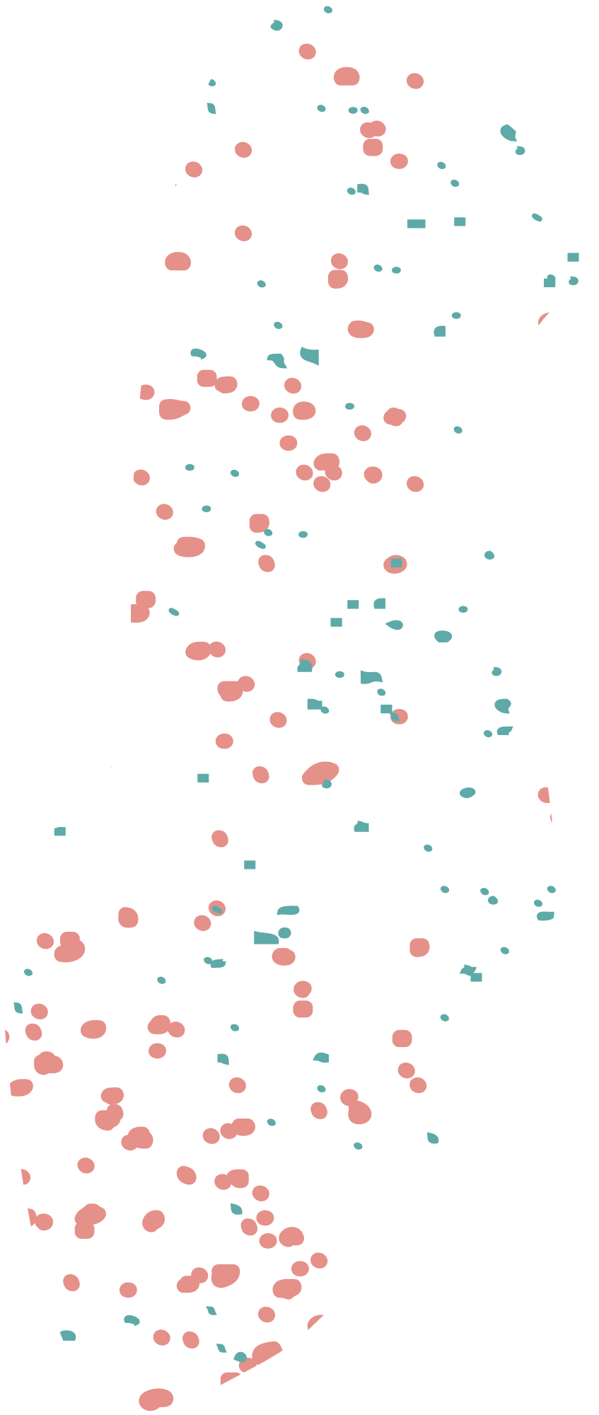


INDIVIDUAL PROCESSING AND RECOMMENDATIONS
INDIVIDUAL FEATURES (AGE,HEIGHT,WEIGHT)
INDIVIDUAL SPORT

Slide 14
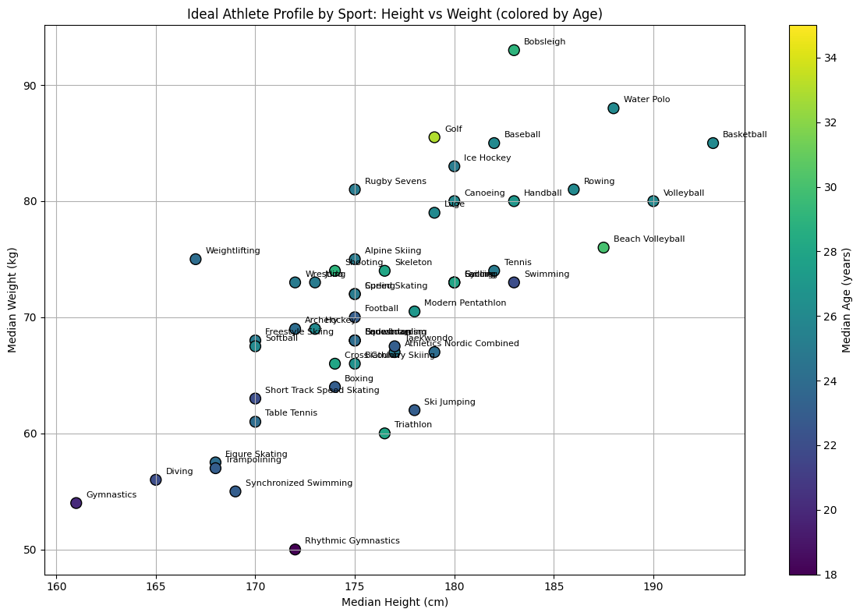

Slide 15
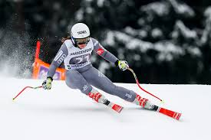
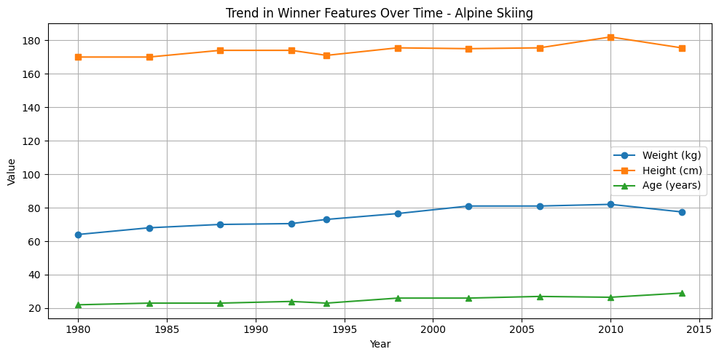
INDIVIDUAL PROCESSING – ALPHINE SKIING

Slide 16
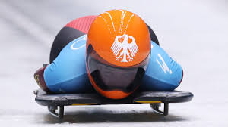
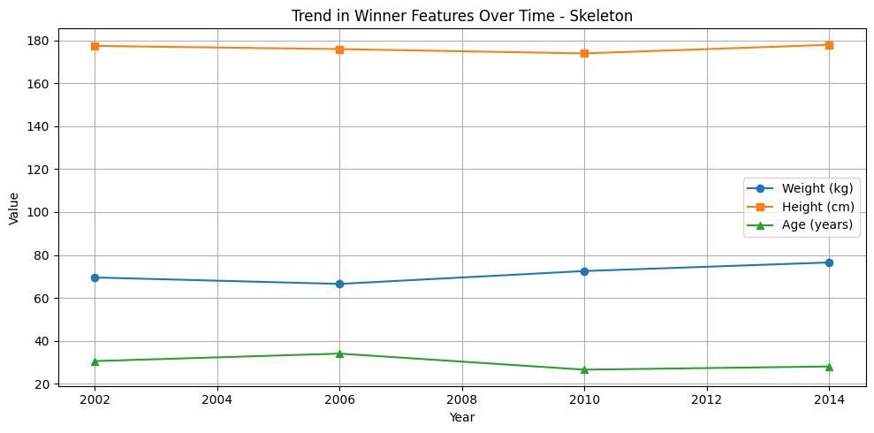
INDIVIDUAL PROCESSING – SKELETON

Slide 17
TRENDS & RECOMMENDATIONS
Include qualitative factors: sports culture, climate, historical context.
01
🎿 Alpine Skiing Trend: Weight and age have gradually increased, height is stable. Recommendation: Focus on building strength and experience, particularly in athletes aged 25–30 with moderate height
02
🥌 Skeleton Trend: Slight increases in weight and age.
Recommendation: Choose sprint-capable athletes with controlled power and aerodynamic
builds.

Slide 18
RECOMMENDATIONS
Include qualitative factors: sports culture, climate, historical context.
01
🎿 Alpine Skiing Trend: Weight and age have gradually increased; height is stable. Recommendation: Focus on building strength and experience, particularly in athletes aged 25–30 with moderate height
02
⚾Baseball Trend: Steady increase in height, weight, and age. Recommendation: Prioritize older, taller, and bulkier players, endurance and power are critical.
03
🎯 Biathlon Trend: Slight decrease in height and weight; age shows some variation.
Recommendation: Focus on younger, leaner athletes with high stamina and technical shooting skills.
04
🛷 Bobsleigh Trend: Significant weight gain; minor height increase; age is stable.
Recommendation: Prioritize powerful, heavier athletes with explosive strength for high-speed starts.

Slide 19
05
Include qualitative factors: sports culture, climate, historical context.
⛵ Sailing Trend: Mild variation across all metrics; older median age.
Recommendation: Experience and strategic thinking matter—support older, tactically adept sailors.
06
⚾Baseball Trend: Steady increase in height, weight, and age. Recommendation:Prioritize older, taller, and bulkier players,endurance and power are critical.
07
🥌 Skeleton Trend: Slight increases in weight and age.
Recommendation: Choose sprint-capable athletes with controlled power and aerodynamic
builds.
08
🏐 Volleyball Trend: Increases in both height and weight; age is stable.
Recommendation: Target tall, strong players with high agility and court awareness in their mid-to-late 20s.
09
🏋️ Weightlifting Trend: Fluctuating weight/height; age stays in low-mid 20s.
Recommendation: Focus on peak power lifters aged 22–26 with compact, powerful builds.

Slide 20
Conclusion:
Olympic success is driven by a combination of participation frequency, economic strength, and population.
Hosting and political regime add little predictive value when controlling for these features.
Predictive modeling is more effective for Summer than Winter Olympics.
Countries can align they’re focus on athletes with certain height and weight to maybe achieve more success in the Olympics.

Slide 21
Limitations:
Country-level models have limited power due to small sample sizes and aggregation.
The models have limited power due to small sample sizes and aggregation.
Dropping missing data (GDP, population) may bias results toward better-documented nations.

Slide 22
Future work:
Include qualitative factors: sports culture, climate, historical context.
01
Integrate sport- and athlete-level features (e.g., government investment, sports diversity).
02
Explore time-series models, more advanced ensemble and neural network models
03
Include qualitative factors: sports culture, climate, historical context.

Slide 23


THANKS!
Do you have any questions?

